Slide 1
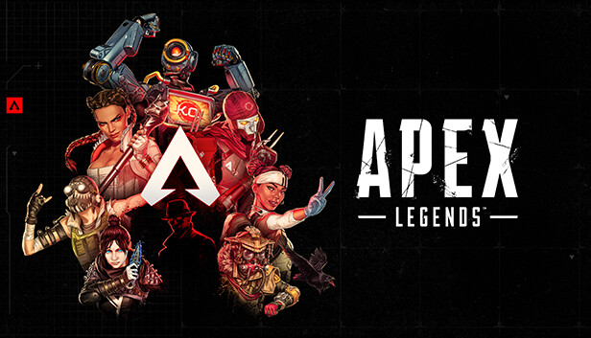
Analysis by Aaron Kerestes

Slide 2

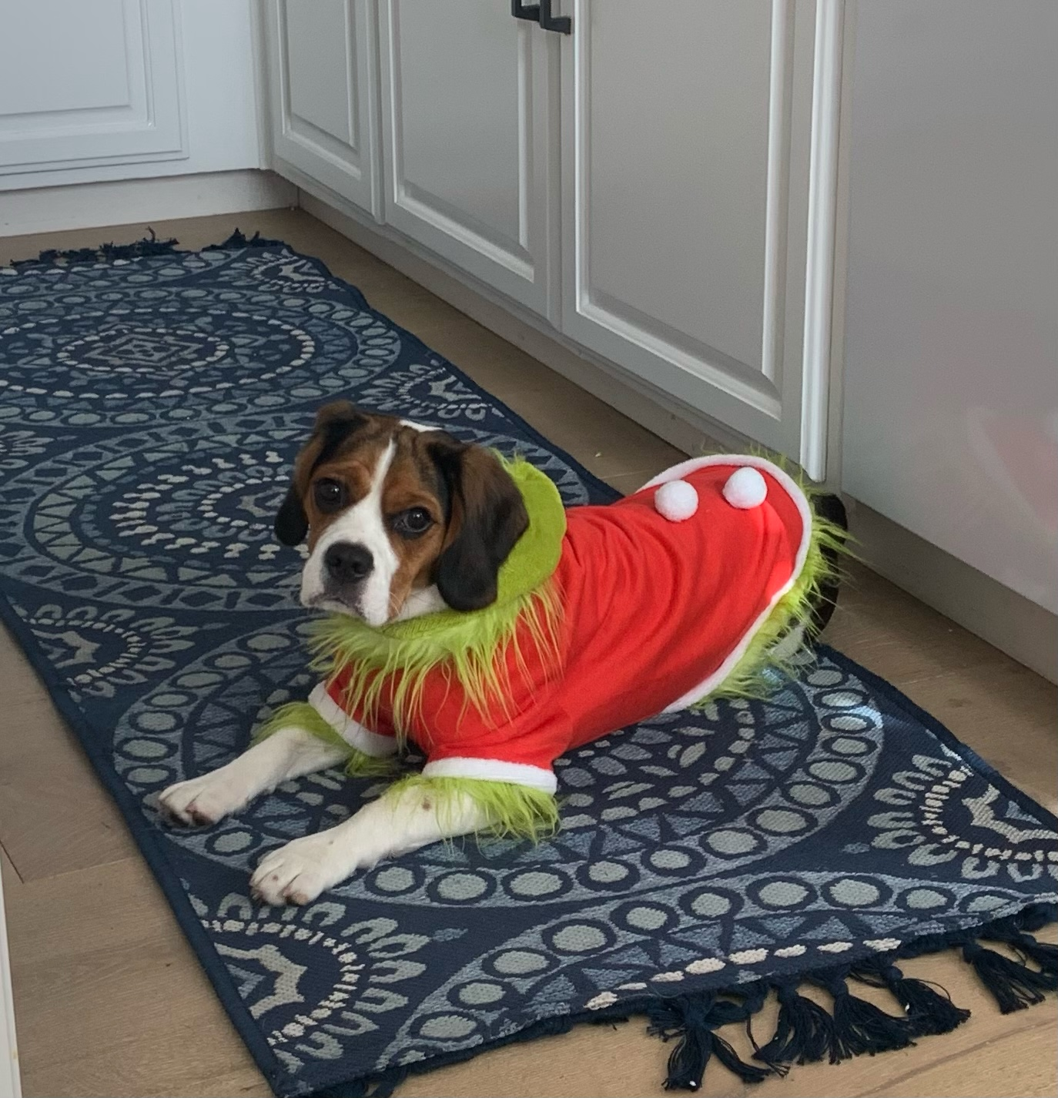



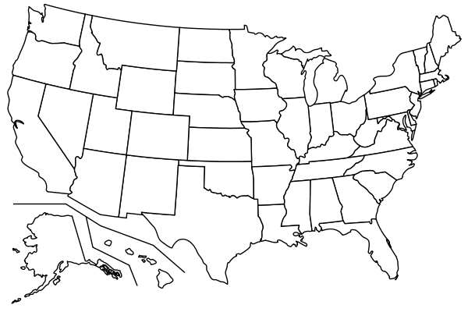
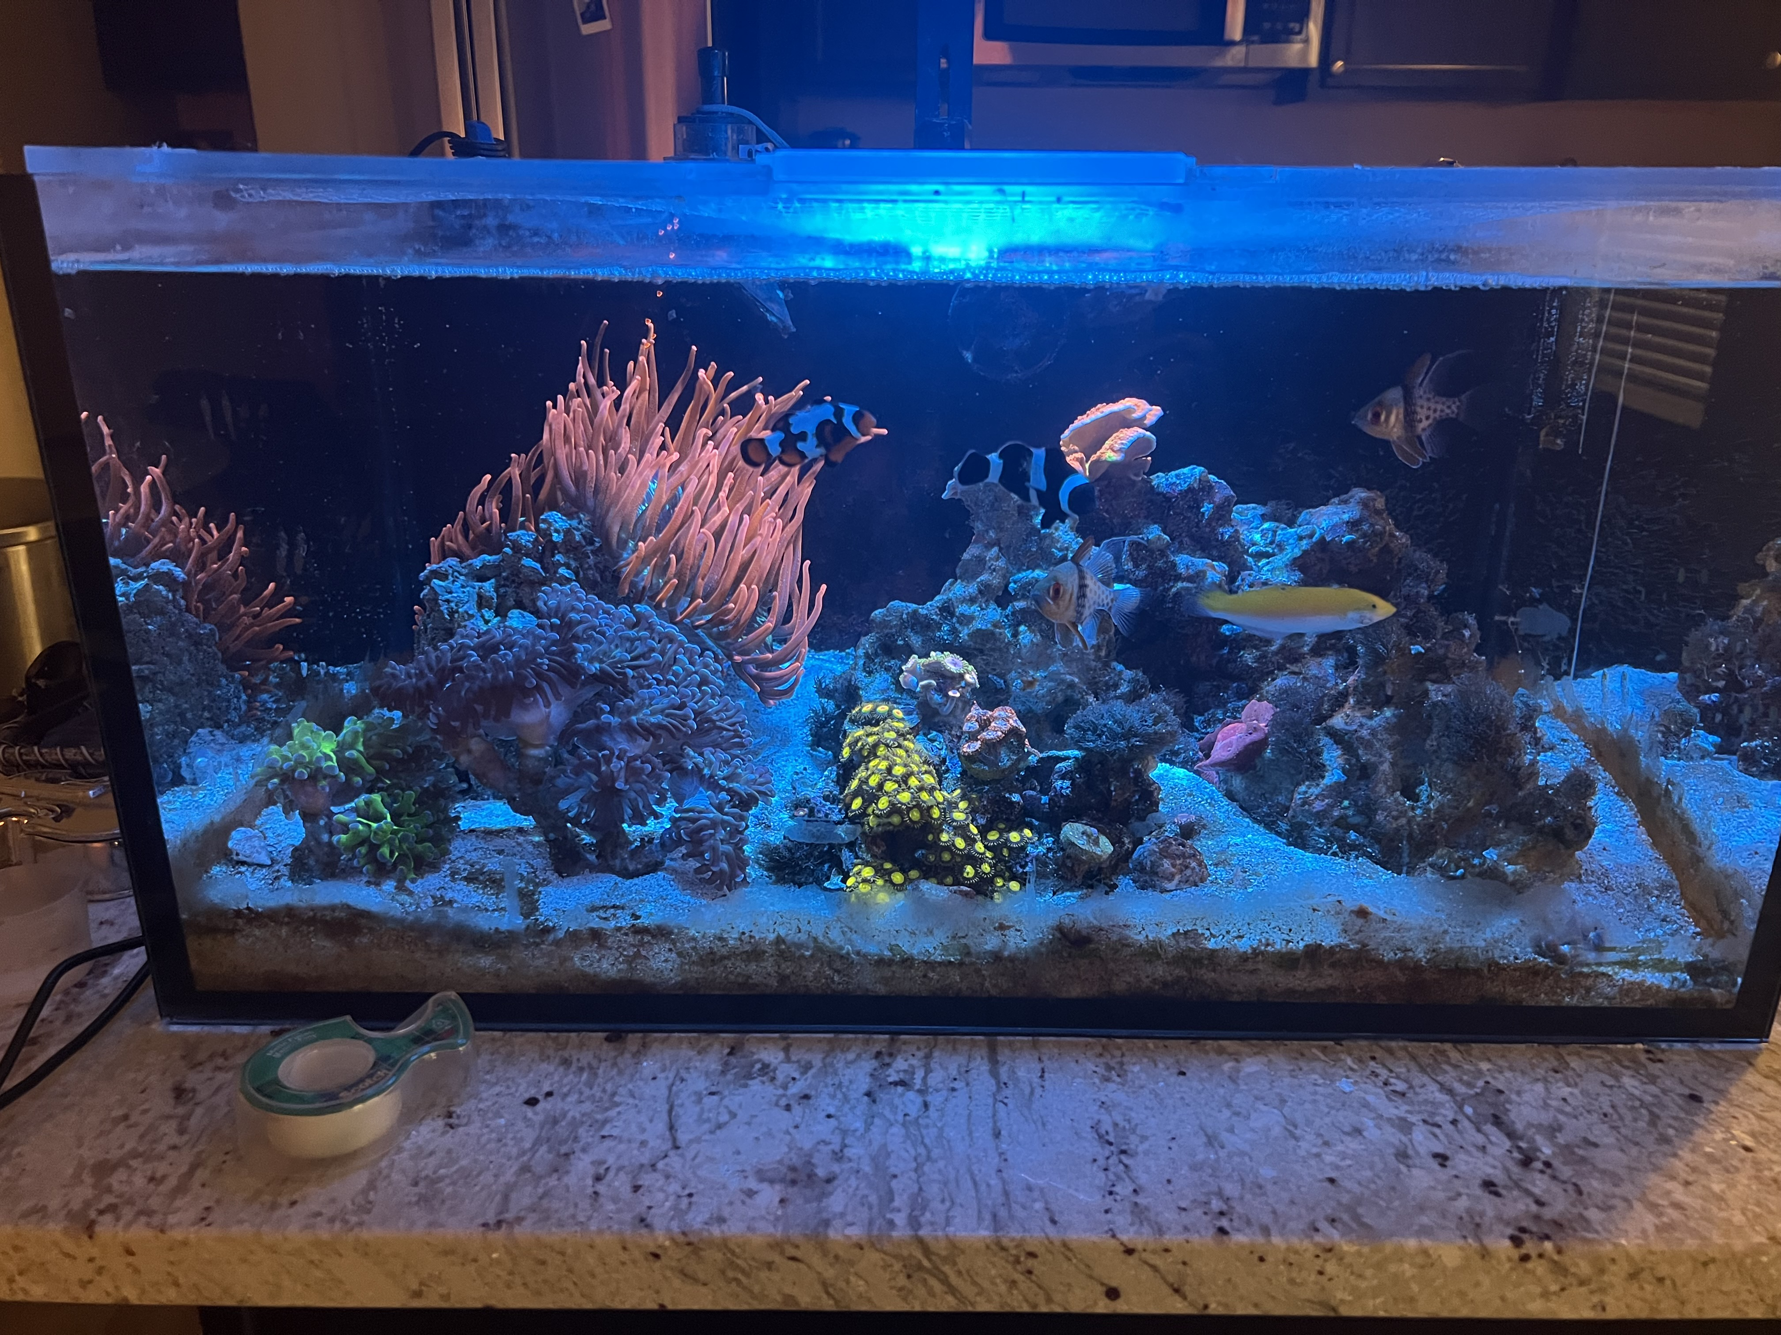

About the Analyst

Slide 3

The Scenario
Apex Legends is a PvP Multiplayer & Battle-Royale video game. The game involves teams of 2-3 players, who are dropped into an arena where they are left to loot for gear and weapons. The ultimate goal is to be the last team standing. Recently the player base has begun to fall. Respawn has hired me as a Data Analyst to diagnose this issue. Some important questions to consider are: listed below:
When did the player base start to fall off?
How many players do we get per day?
What’s driving the decline in usage?
How can we improve our model to develop the Apex brand?

Slide 4
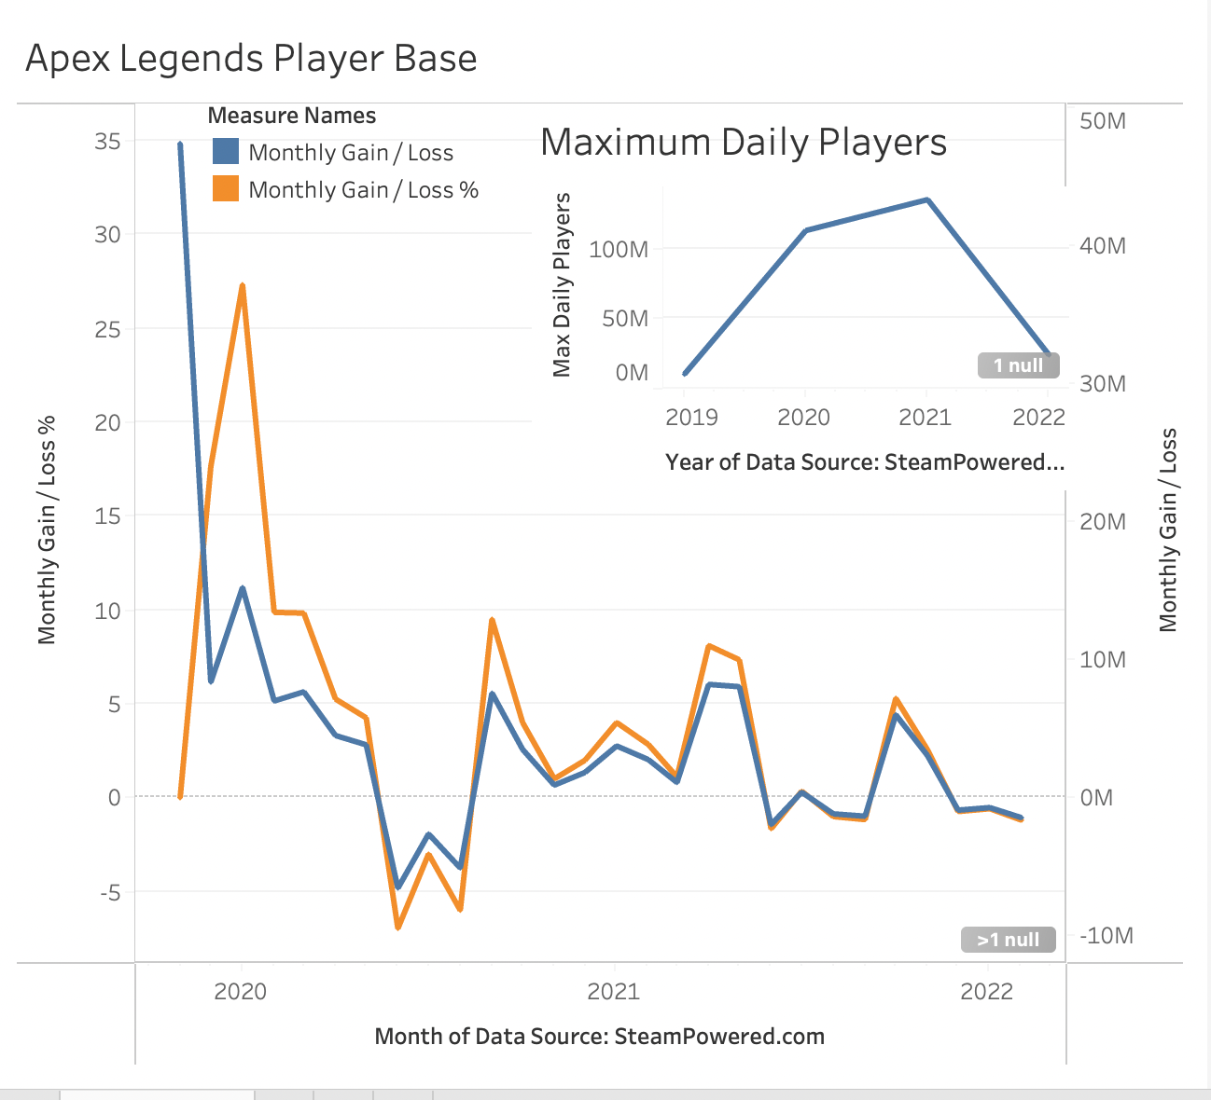
What does the data say?
Average Daily Players: 9.8M
2020: ~100M players
2021: ~140M players
Player base begins to drop in 2021
Launch of new games
Small Spikes of increase mid-2020 and 2021
In-game content, engagement for players
Source: Kaggle.com, Apex Legends Monthly Player Base

Slide 5

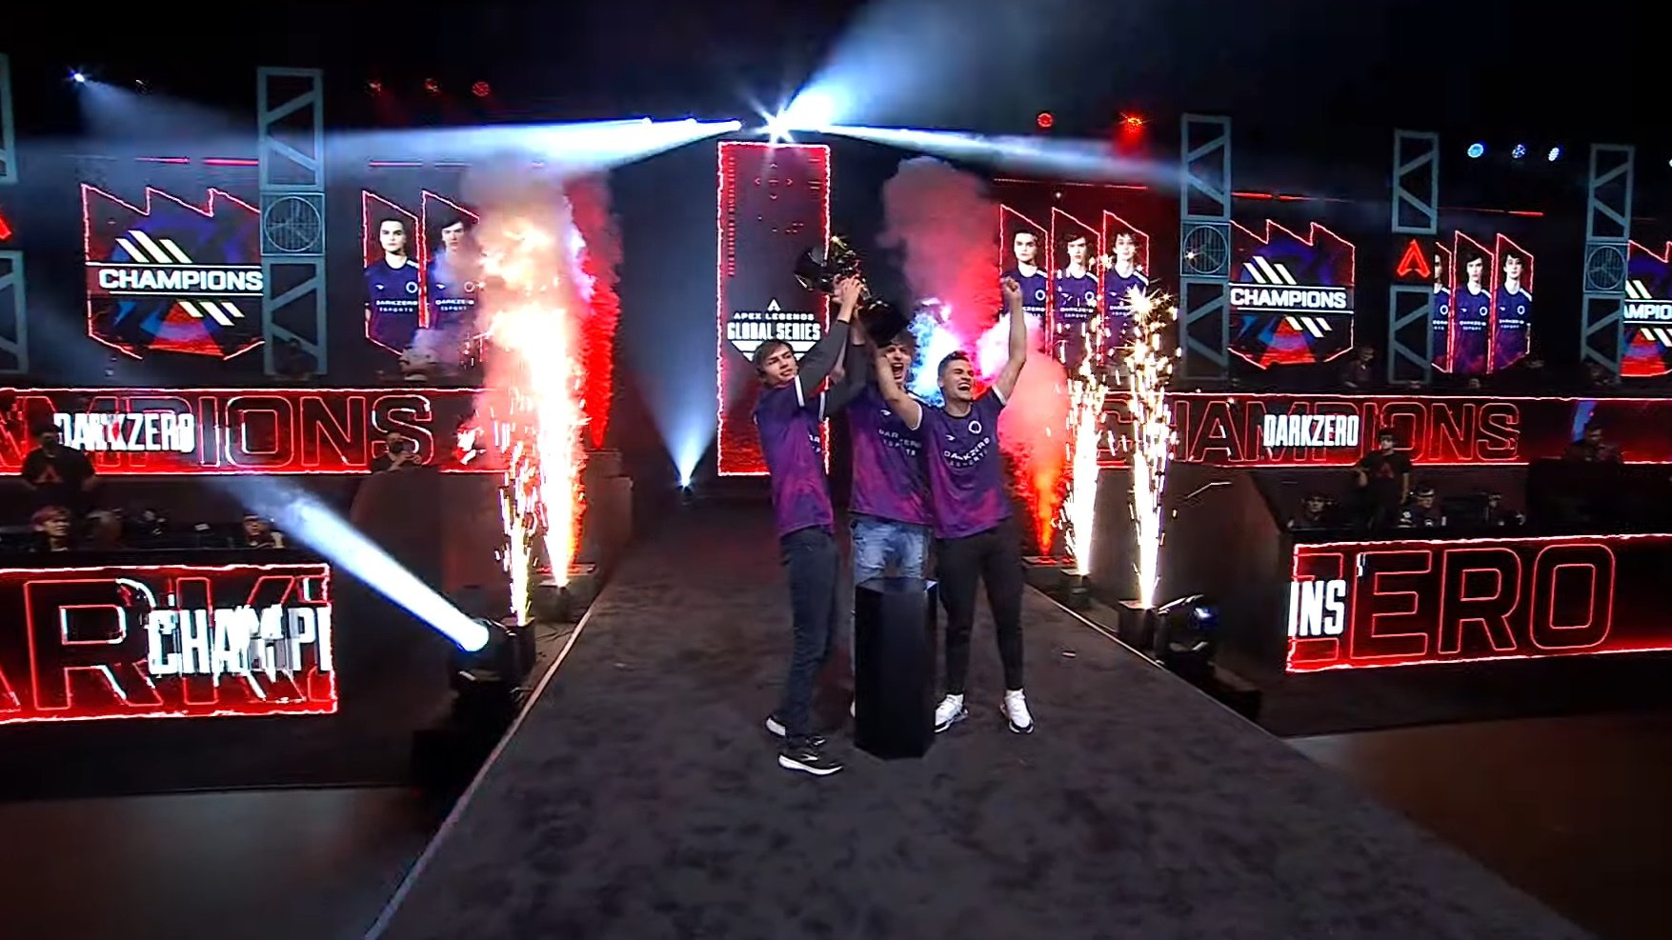
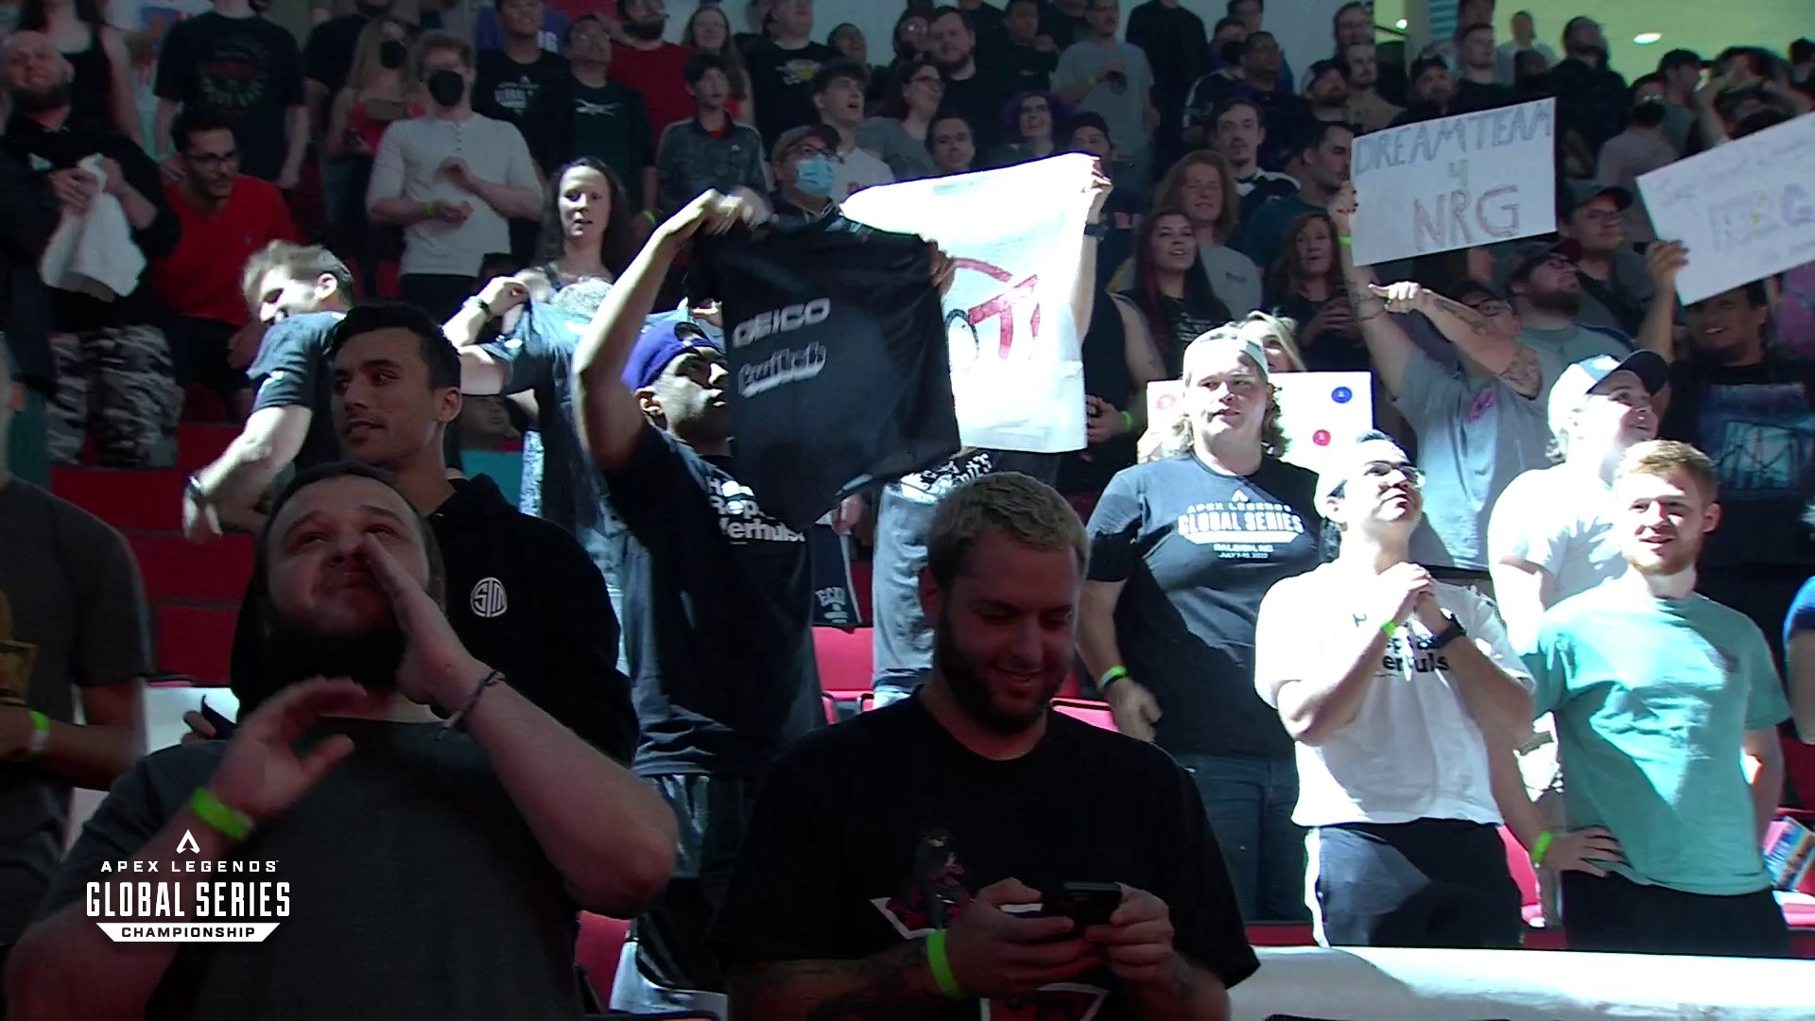
Brand & Community
Competitiveness creates a strong fan base
Players’ opinions carry a lot of weight with fans
Connecting with pro players and content creators will resonate deep with consumers
Buzz Words from game reviews:
Competitive
Fast-paced
“Sweaty”
Matchmaking

Slide 6
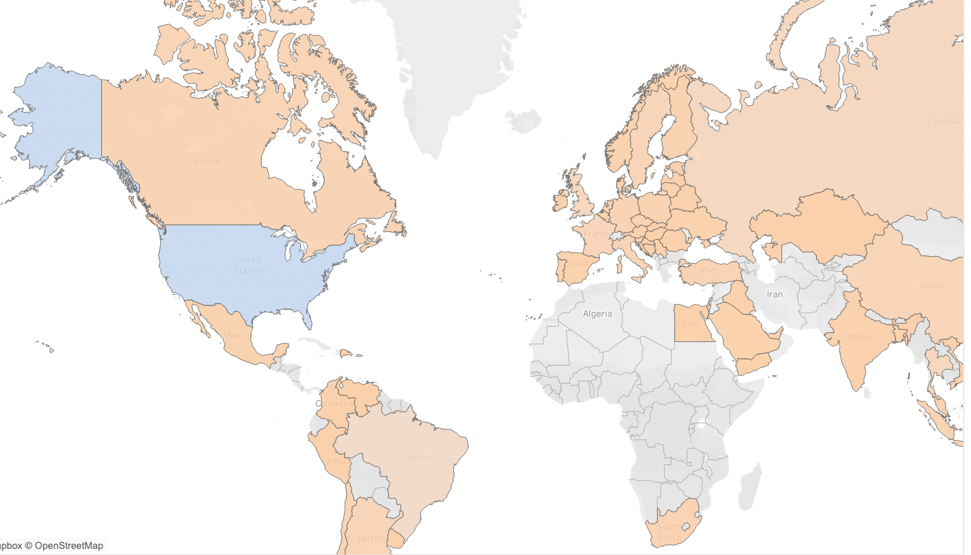
Professional Players
Players based in developed/developing countries
North/South America make up ~35% of players
1 of every 3 players belong to an organization
Source: Jonathan Bouchet, Apex Legends player_info

Slide 7

Conclusion
Apex Legends did well retaining its player base in early stages
As new games come out, more gaming options become available and consumers are looking for alternatives
Focusing on reconnecting with creators and the community will help build loyalty among consumers
Spokespeople for the game are moving to other games to play as Battle-Royale modes are becoming less popular

Slide 8

Next Steps
Follow-up with spokespersons for the games with surveys to be completed with audiences on Twitch
Create a sense of inclusiveness to the community
Develop a new game mode that is not Battle-Royale style
Work on penetrating the markets within Europe, Middle East and Australia
Incentivize players to return to the game through “Freemium” content and an updated matchmaking algorithms

Slide 9
Thank You!
Questions?

